Slide 1
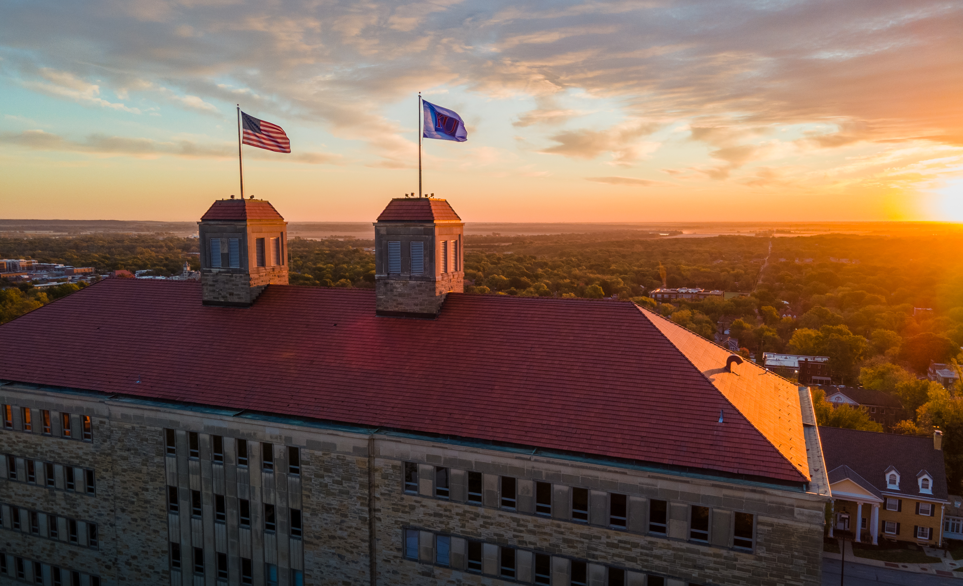
The Relevance of the Kalven report
Arash Mafi, March 4, 2026

Slide 2
The Committee was appointed in February 1967 by President George W. Beadle and requested to prepare “a statement on the University’s role in political and social action.” The Committee conceives its function as principally that of providing a point of departure for discussion in the University community of this important question.

Slide 3
The Committee has reviewed the experience of the University in such matters as its participation in neighborhood redevelopment, its defense of academic freedom in the Broyles Bill inquiry of the 1940s and again in the Jenner Committee hearings of the early 1950s, its opposition to the Disclaimer Affidavit in the National Defense Education Act of 1958, its reappraisal of the criteria by which it rents the off-campus housing it owns, and its position on furnishing the rank of male students to Selective Service.

Slide 4
In its own discussions, the Committee has found a deep consensus on the appropriate role of the university in political and social action. It senses some popular misconceptions about that role and wishes, therefore, simply to reaffirm a few old truths and a cherished tradition.

Slide 5
A university has a great and unique role to play in fostering the development of social and political values in a society. The role is defined by the distinctive mission of the university and defined too by the distinctive characteristics of the university as a community. It is a role for the long term.

Slide 6
The mission of the university is the discovery, improvement, and dissemination of knowledge. Its domain of inquiry and scrutiny includes all aspects and all values of society. A university faithful to its mission will provide enduring challenges to social values, policies, practices, and institutions. By design and by effect, it is the institution which creates discontent with the existing social arrangements and proposes new ones. In brief, a good university, like Socrates, will be upsetting.

Slide 7
The instrument of dissent and criticism is the individual faculty member or the individual student. The university is the home and sponsor of critics; it is not itself the critic. It is, to go back once again to the classic phrase, a community of scholars. To perform its mission in the society, a university must sustain an extraordinary environment of freedom of inquiry and maintain an independence from political fashions, passions, and pressures.

Slide 8
A university, if it is to be true to its faith in intellectual inquiry, must embrace, be hospitable to, and encourage the widest diversity of views within its own community. It is a community but only for the limited, albeit great, purposes of teaching and research. It is not a club, it is not a trade association, it is not a lobby.

Slide 9
Since the university is a community only for these limited and distinctive purposes, it is a community which cannot take collective action on the issues of the day without endangering the conditions for its existence and effectiveness. There is no mechanism by which it can reach a collective position without inhibiting that full freedom of dissent on which it thrives.

Slide 10
It cannot insist that all of its members favor a given view of social policy; if it takes collective action, therefore, it does so at the price of censuring any minority who do not agree with the view adopted. In brief, it is a community which cannot resort to majority vote to reach positions on public issues.

Slide 11
The neutrality of the university as an institution arises then not from a lack of courage nor out of indifference and insensitivity. It arises out of respect for free inquiry and the obligation to cherish a diversity of viewpoints. And this neutrality as an institution has its complement in the fullest freedom for its faculty and students as individuals to participate in political action and social protest. It finds its complement, too, in the obligation of the university to provide a forum for the most searching and candid discussion of public issues.

Slide 12
Moreover, the sources of power of a great university should not be misconceived. Its prestige and influence are based on integrity and intellectual competence; they are not based on the circumstance that it may be wealthy, may have political contacts, and may have influential friends.

Slide 13
From time to time instances will arise in which the society, or segments of it, threaten the very mission of the university and its values of free inquiry. In such a crisis, it becomes the obligation of the university as an institution to oppose such measures and actively to defend its interests and its values.

Slide 14
There is another context in which questions as to the appropriate role of the university may possibly arise, situations involving university ownership of property, its receipt of funds, its awarding of honors, its membership in other organizations. Here, of necessity, the university, however it acts, must act as an institution in its corporate capacity. In the exceptional instance, these corporate activities of the university may appear so incompatible with paramount social values as to require careful assessment of the consequences.

Slide 15
These extraordinary instances apart, there emerges, as we see it, a heavy presumption against the university taking collective action or expressing opinions on the political and social issues of the day, or modifying its corporate activities to foster social or political values, however compelling and appealing they may be.
These are admittedly matters of large principle, and the application of principle to an individual case will not be easy.

Slide 16
It must always be appropriate, therefore, for faculty or students or administration to question, through existing channels such as the Committee of the Council or the Council, whether in light of these principles the University in particular circumstances is playing its proper role.
Our basic conviction is that a great university can perform greatly for the betterment of society. It should not, therefore, permit itself to be diverted from its mission into playing the role of a second-rate political force or influence.

